Slide 1

Team IC22035: The Armed Conflict Location Event Data
Tai Ngo & Eduardo Gonzalez

Slide 2
About Team IC22035
We are team of two students studying computer science and engineering at Montgomery College.
We wanted to challenge ourselves by learning an entirely new field – data science!
Over the course of a single week, we picked up Tableau, ArcGIS, and Jupyter Notebook.
Data is beautiful and can help us understand the world better!

Slide 3
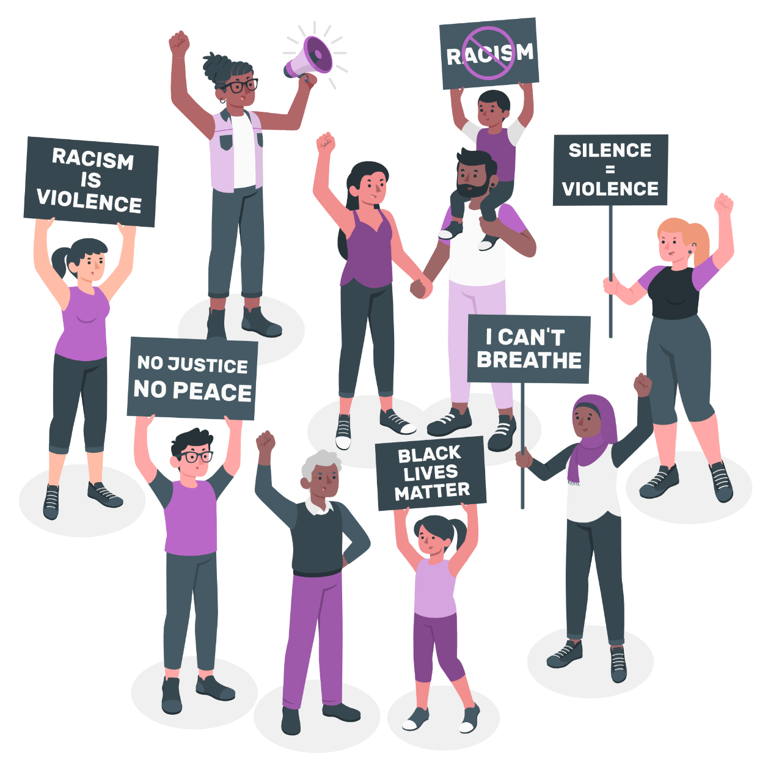
Introduction
On May 25, 2020, Minneapolis police killed George Floyd, an unarmed Black man, igniting nationwide demonstrations.
More than Black Lives Matter 11,000 protests
Since the midsummer of 2020, demonstration rates have dropped dramatically
Protests still endure throughout 2021
We investigate how and why the protest demonstration spreads over time
To understand the reaction to several police force incidents in the United States.
We used four incidents as model cases

Slide 4
Dataset Introduction
The Armed Conflict Location & Event Data Project (ACLED)
Designed to collect real-time data on
Locations
Dates
Actors
Fatalities
Types of all reported political violence and protests

Slide 5
Process Diagrams
Collection
Cleaning
Exploratory Data Analysis
Visualization
Stage 1
Stage 2
Stage 3
Stage 4

Slide 6

Procedure
1
Look at multiple controversial police incidents from 2020 and 2021
2
Narrow down the dataset and focus on specific dates of the incidents
3
See a change in number of protests, and location

Slide 7
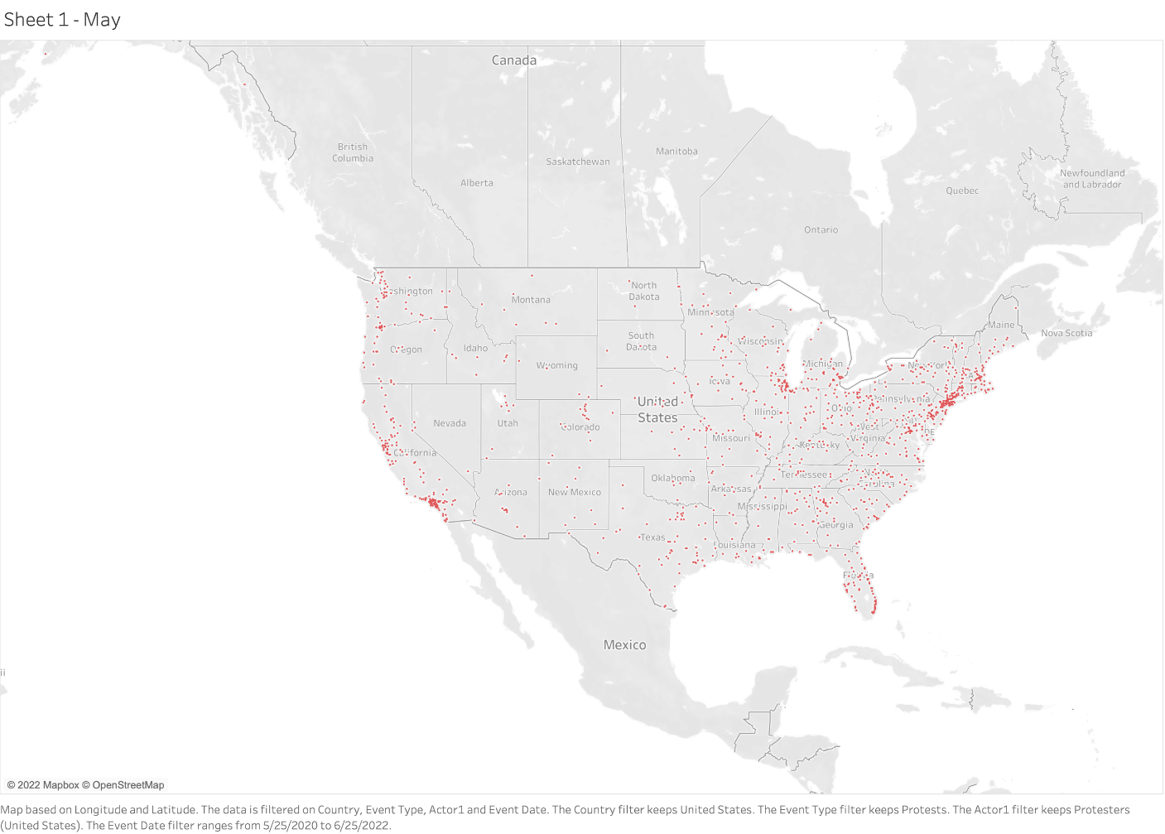
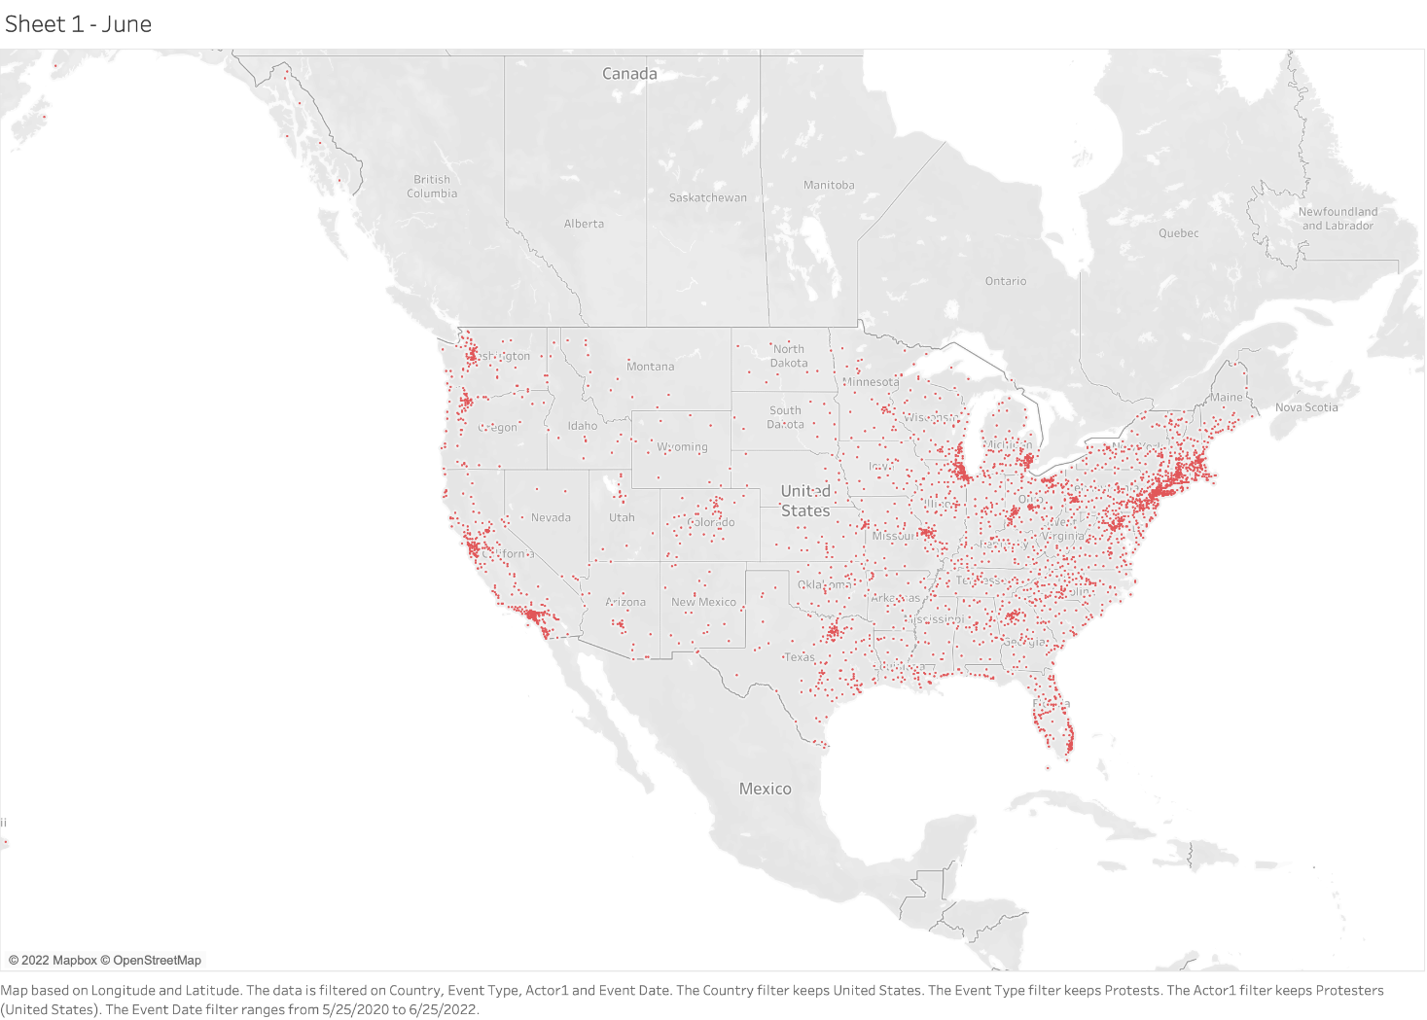
May 2020
June 2020

Slide 8

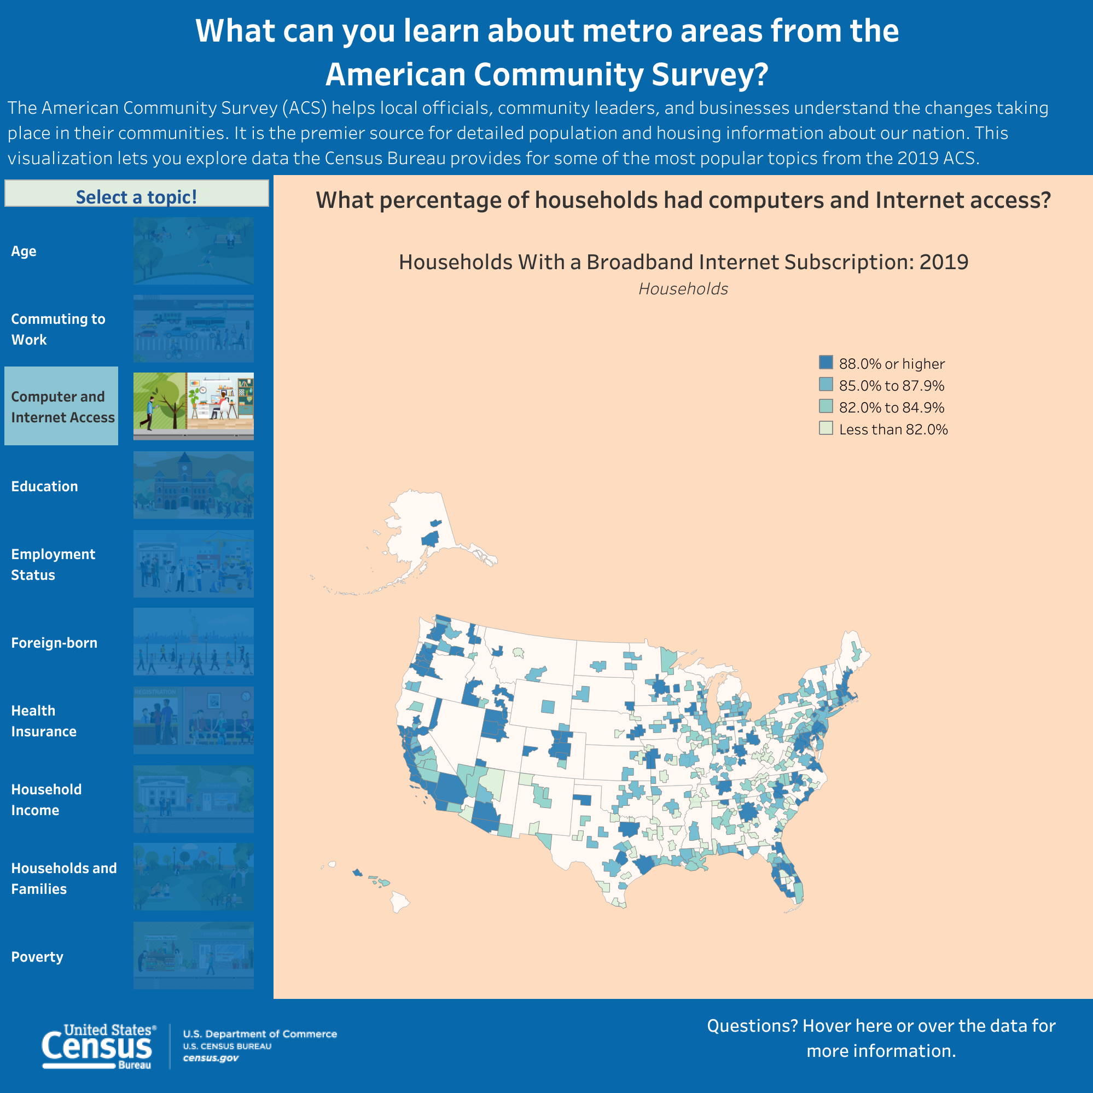
Percentage of Householdswith Computer/Internet Access (2019)
Census.gov

Slide 9

Data Explained
Derek Chauvin, a police officer, kept his knee on Floyd's neck for about nine minutes, despite Floyd's repeated "I can't breathe" statements and final unresponsiveness.
The entire event was captured on video.
Middle of the coronavirus epidemic, which has forced Americans to stay at home
The entire country is under lockdown
More people are staying indoors watching television
Unemployment level means that more people than usual can protest and campaign without juggling work commitments.

Slide 10
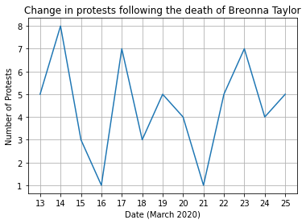
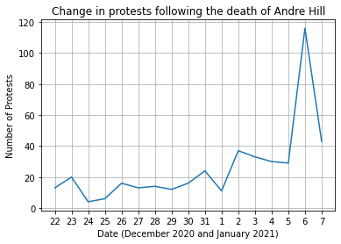
Data
Average number of protest per day: 4.5
Maximum number of protests in a day: 8
Average number of protest per day: 25.7
Maximum number of protests in a day: 116

Slide 11
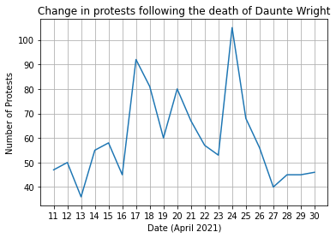
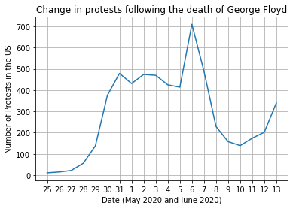
Data Continued
Average number of protest per day: 59.3
Maximum number of protests in a day: 105
Average number of protest per day: 287.6
Maximum number of protests in a day: 710

Slide 12
The Data Explained
Breonna Taylor’s and Andre Hill’s graph results show minimal increase in protests following the incidents.
However, George Floyd’s and Daunte Wright’s graphs show a higher mean and maximum value.
All these incidents are extremely controversial, but some have more impact when it comes to changing in protests.

Slide 13
Why is this the case?
Media coverage is difficult to predict, some cases will get promoted more than others.
George Floyd’s case sparked a greater change in protests because it happened after various incidents, which made people more upset and hungrier for justice.
The COVID-19 pandemic reduced the amount of people willing to protest.

Slide 14

Data Explained
The results of the first two-line graphs regarding the cases of Breonna Taylor and Andre Hill were surprising.
Both the average number of protests per day and the maximum were low for Breonna Taylor.
The fact that this incident occurred when the pandemic restrictions were starting to increase may explain this results.
Even though the results for the second graph were higher, they are inflated by the January 6th capitol attack that occurred a few days after the death of Andre Hill.
Graphs involving the deaths of George Floyd and Daunte Wright show a higher mean value and max value.
Floyd’s results show the impact his case generated in the US.
Even despite the pandemic, the maximum number of protests surpasses 700.

Slide 15
Next Steps
Look at infrastructure, e.g. transportation means
Look at confounding factors
Psychological profiles
Political affiliation

Slide 16
Summary
The impact of social media on modern protest movements
Provides a voice to individuals who would otherwise be silenced by giving a platform for the underrepresented.
Makes it simple for political parties and demonstrators to arrange events and distribute information
Global opinions to be shared.

Slide 17
Thank you for the opportunity to participate in IC2022!
Special thanks to Sami and Jeff Henrikson for helping us throughout the event

